Slide 1
Notes for the teachers
Dear colleagues,
I like to request you to follow the notes below the slides. If you feel any lacking,
recover it yourself. In case of any inquiry please call me to 01717220115.
Yours Hasan Cambrian
Cambrian School & College, Dhaka
Notes:
Please follow the instructions here.

Slide 2
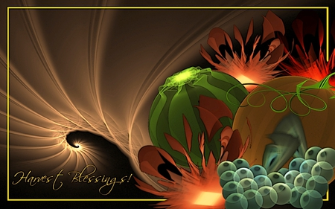
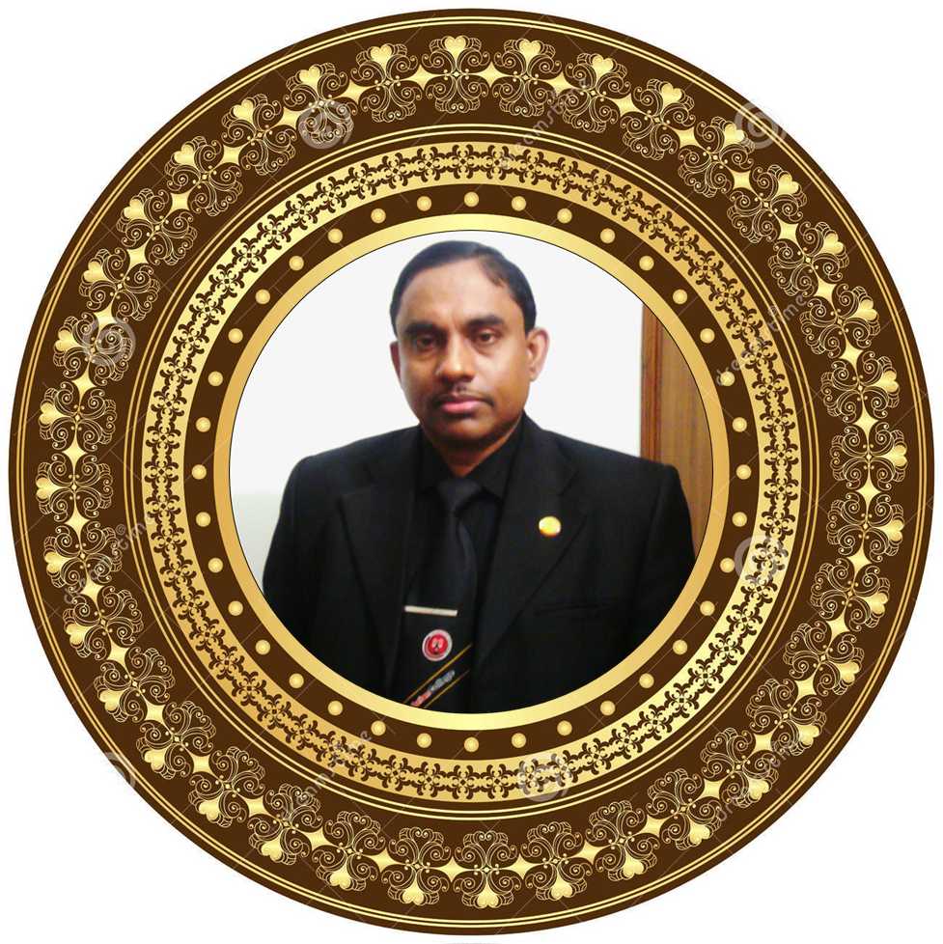
Welcome

Slide 3

Identity of the content builder
Md. Hasan Hafizur Rahman
Lecturer & Head of the Department (English)
Cambrian School & College, Dhaka
Email: hasancambrian@ gamil.com
Cell : 01717220115
Presentation made for class VI-IX
English 2nd paper
Grammar

Slide 4

george bernard shaw was born in dublin in 1856. his father's family had been small landowners in ireland since the late seventeenth century. he was awarded nobel prize for literature in november 1950.
George Bernard Shaw was born in Dublin in 1856. His father's family had been small landowners in Ireland since the late seventeenth century. He was awarded Nobel Prize for literature in November 1950.
What have you observed?
Capitalization

Slide 5

Our today’s lesson is-
Capitalization

Slide 6

Learning outcomes
At the end of the lesson we will be able to-
identify the definition of capitalization
use capitalization
Notes:
The above target will be achieved from this lesson.

Slide 7
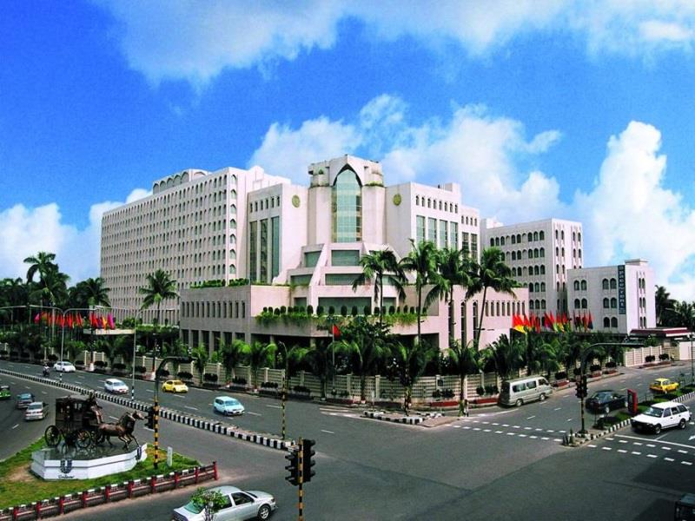
What is capitalization?
dhaka is the capital of bangladesh. we live in dhaka.
it is an old city. emperor jahangir established this city.
Capitalization means the method of using capital letters.

Slide 8
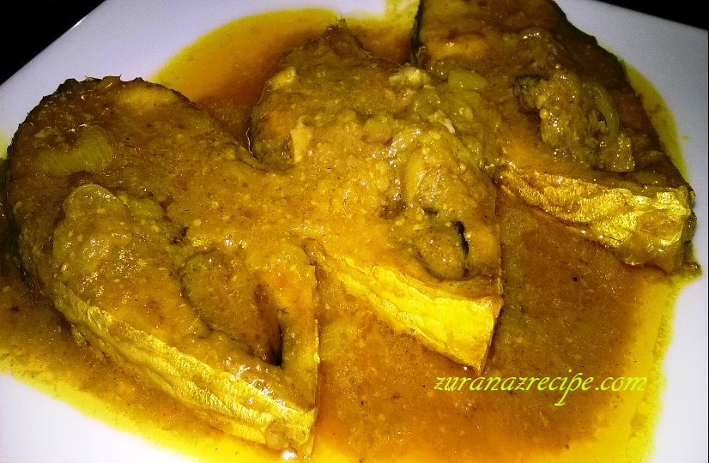
Capitalization-1
the fish curry looks appetizing.
The fish curry looks appetizing.
The first letter of the sentence should be capital.

Slide 9
Capitalization-2
The music in my heart I bore
Long after it was heard no more.
The first letter of each sentence should be capital in all the English poems.

Slide 10
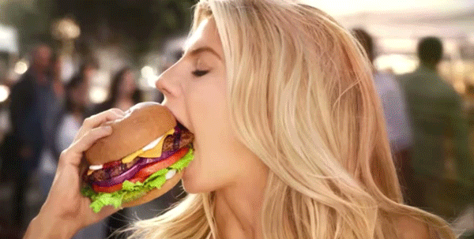
Capitalization-3
Proper Noun
She is Julee and she likes
American burgers.
Proper Adjective
The first letter of proper nouns and
proper adjectives must be capital.

Slide 11
Capitalization-4
January, February, March, April, May, June, July,
August, September, October, November and December
Saturday, Sunday, Monday, Tuesday, Wednesday, Thursday and Friday
The first letter of the month and day will be capital.

Slide 12
Capitalization-5
Our Annual Exam will be held on December.
The first letter of a term will be capital.

Slide 13
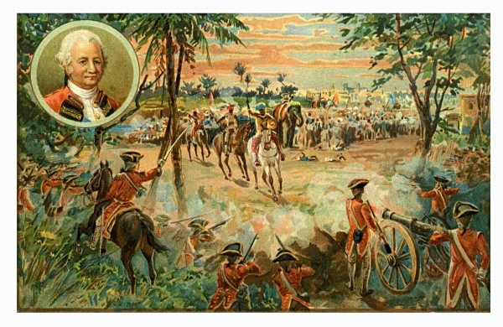
Capitalization-6
The Battle of Palassey
The first letter of any historical event will be capital.
Notes:
The person seen in the picture is Robert Clive, the commander of British.

Slide 14

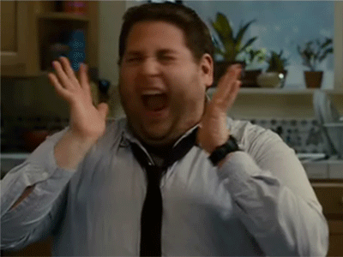
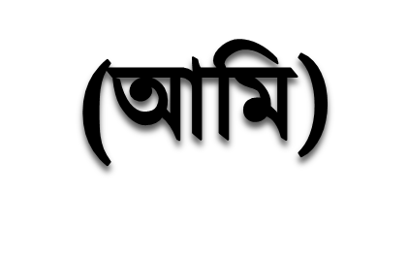
Capitalization-7
Please don’t tell me a fat man,
I am not fat, aa-aa-aa.
Pronoun ‘I’ used as subject must be capital .
Notes:
Go according to animation.

Slide 15
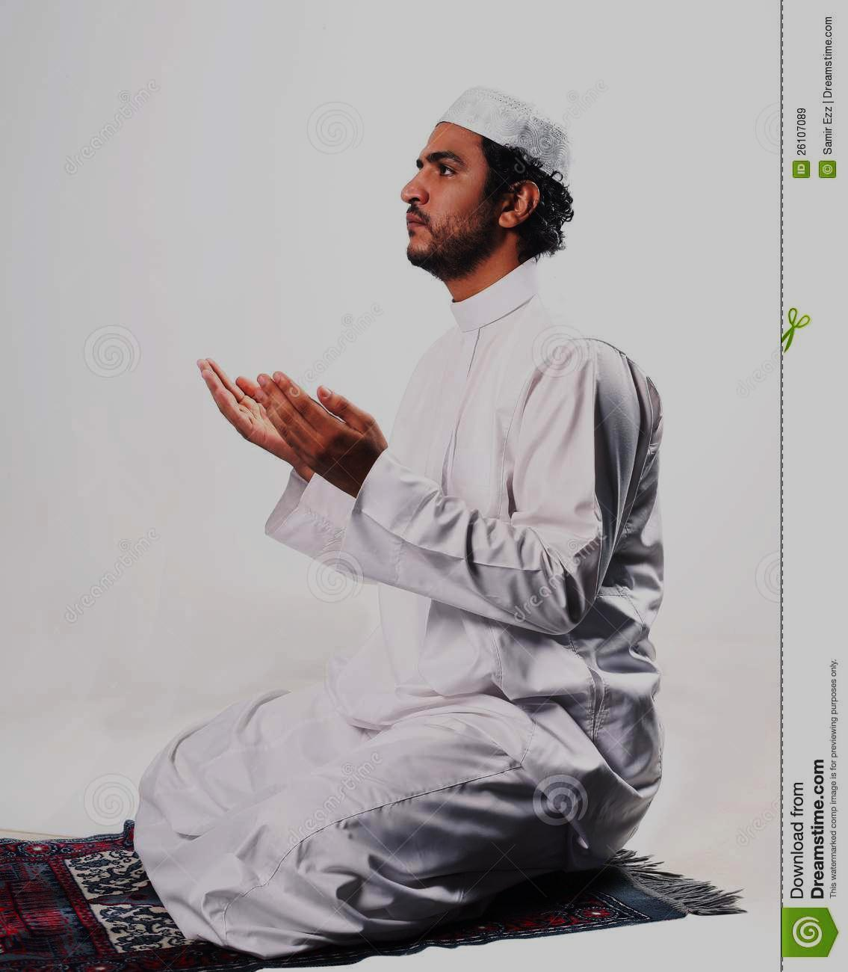
Capitalization-8
O Allah! forgive me.
He prayed to God and He granted his prayer.
First letter of Interjection and God/Allah as naming words and their pronouns will be capital.
Notes:
Go according to animation.

Slide 16

Capitalization-9
He is a BA.
My dear Mother, Sir.
He said, “There is no alternative of mother in the earth.”
Abbreviation letters, addressing letters and
first letter of Quotation must be capital.
Notes:
Go according to animation.

Slide 17
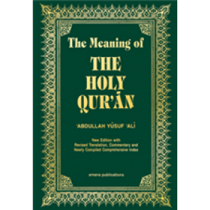
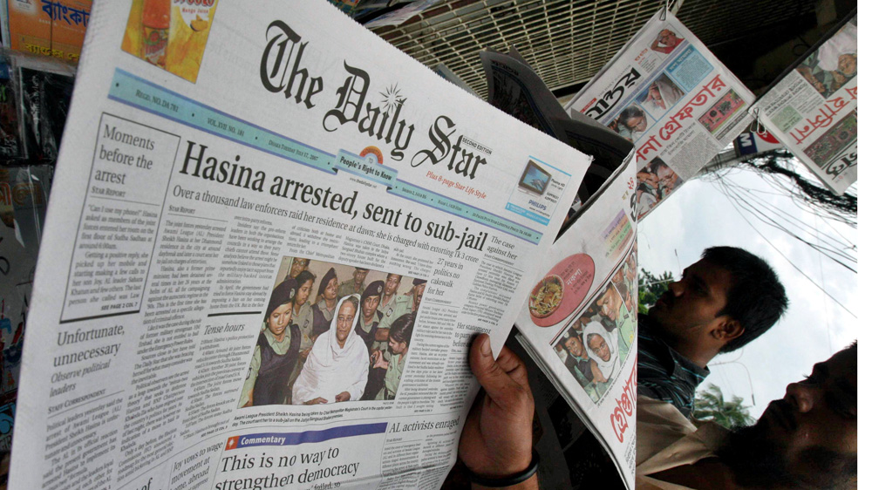
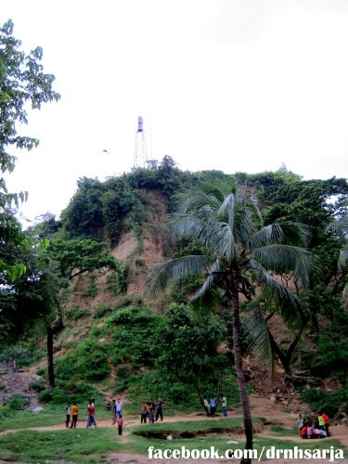
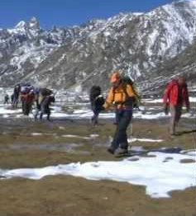
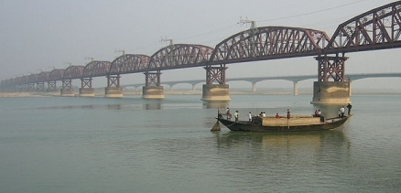

Capitalization-10
The Quran
The Batali Hill
The Kanchenjunga
The Padma river
Capital letter is used in the first letter of any
treatise, newspaper, hill, mountain, river, sea etc.
Notes:
The Batali hill is the highest hill in Chittagong city, The Kanchenjunga is the third highest mountain in the world in India near Darjeeling.

Slide 18


Capitalization-11
First letter of any institution should be a capital letter.
Notes:
Go according to animation.

Slide 19


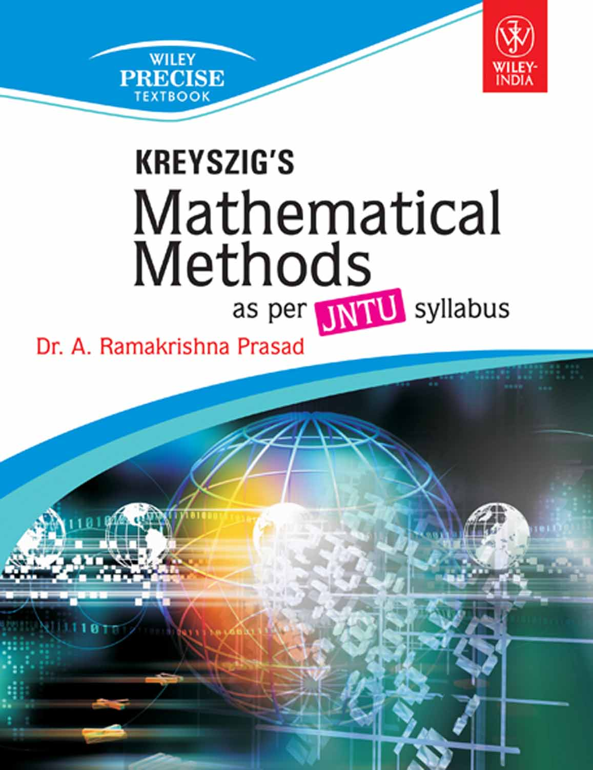
Capitalization-12
English For Today
Bengali Literature
First letter of any subject read in schools and colleges should be capital.
Notes:
Go according to animation.

Slide 20
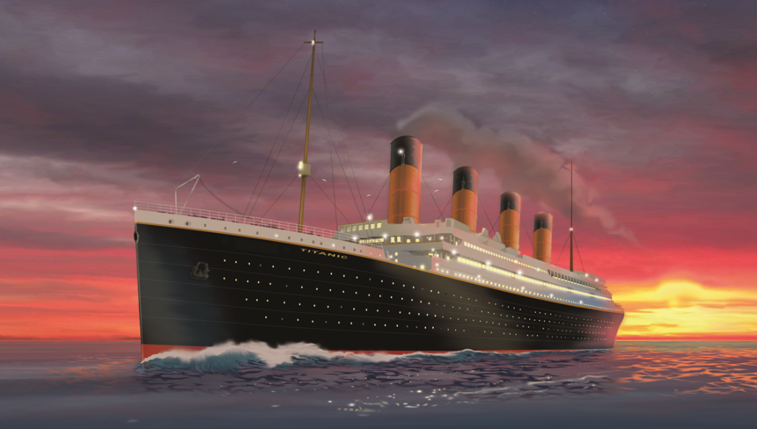
Capitalization-13
The Titanic
Capital letter is used at the first letter of the word of a great ship.
Notes:
Go according to animation.

Slide 21
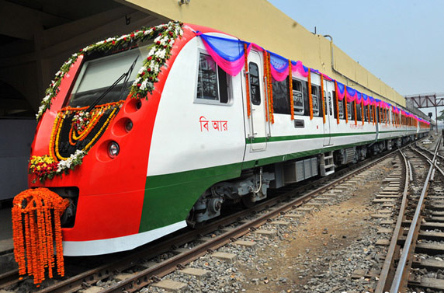
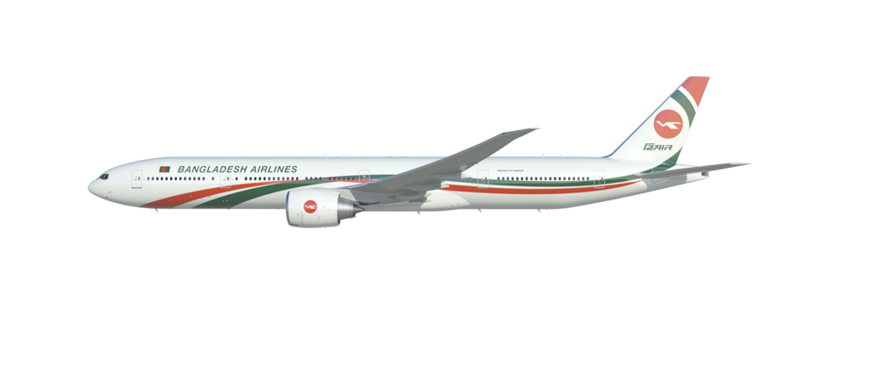
Bangladesh Railway
Capital letter is used at the first letter of the word of an express.
Notes:
Go according to animation.

Slide 22
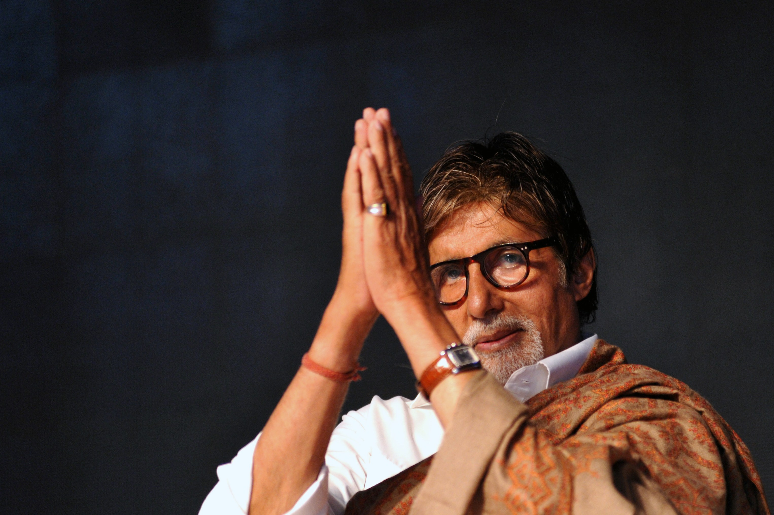
Capital letter is used at the first letter of the word of nations.
Indian
Notes:
Go according to animation.

Slide 23
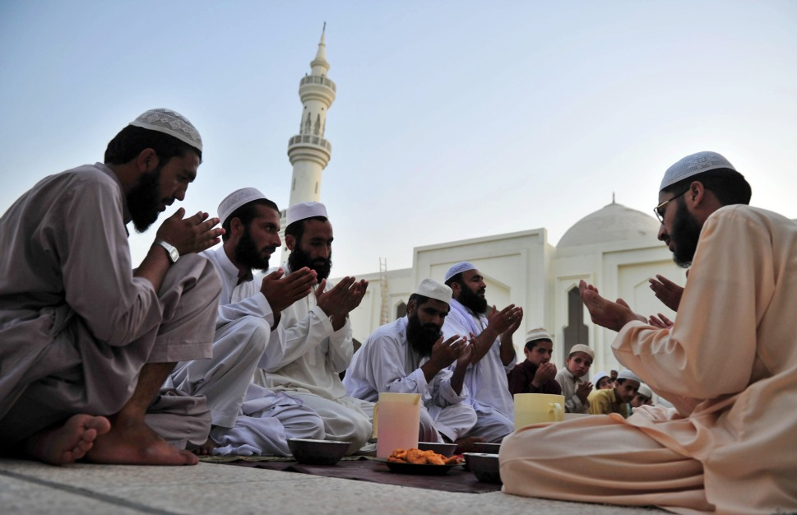
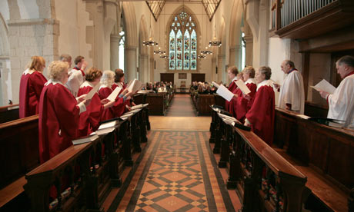
Capitalization-15
The Muslim
The Christian
Capital letter is used at the first letter of the word of religions.
Notes:
Go according to animation.

Slide 24
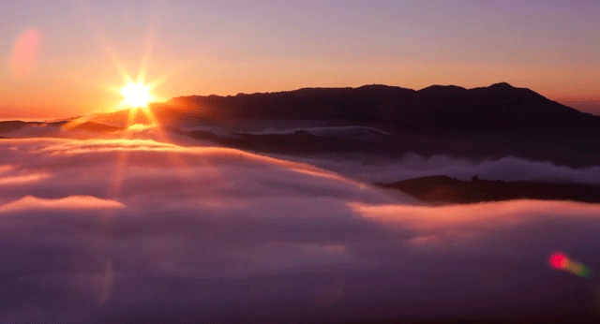
Capitalization-16
The sun rises in the east.
He passed his whole life in the East.
Normally small letter is used at the first letter of the world
‘north-east-south-west’ but capital letter is used when they mean region.
Notes:
Go according to animation.

Slide 25
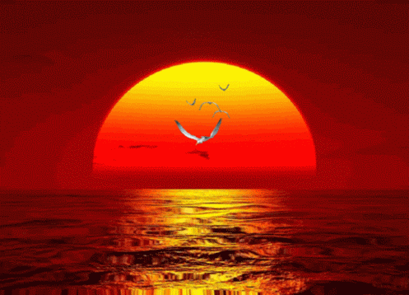
May Allah bless you.
Notes:
Ending slide.

